Slide 1
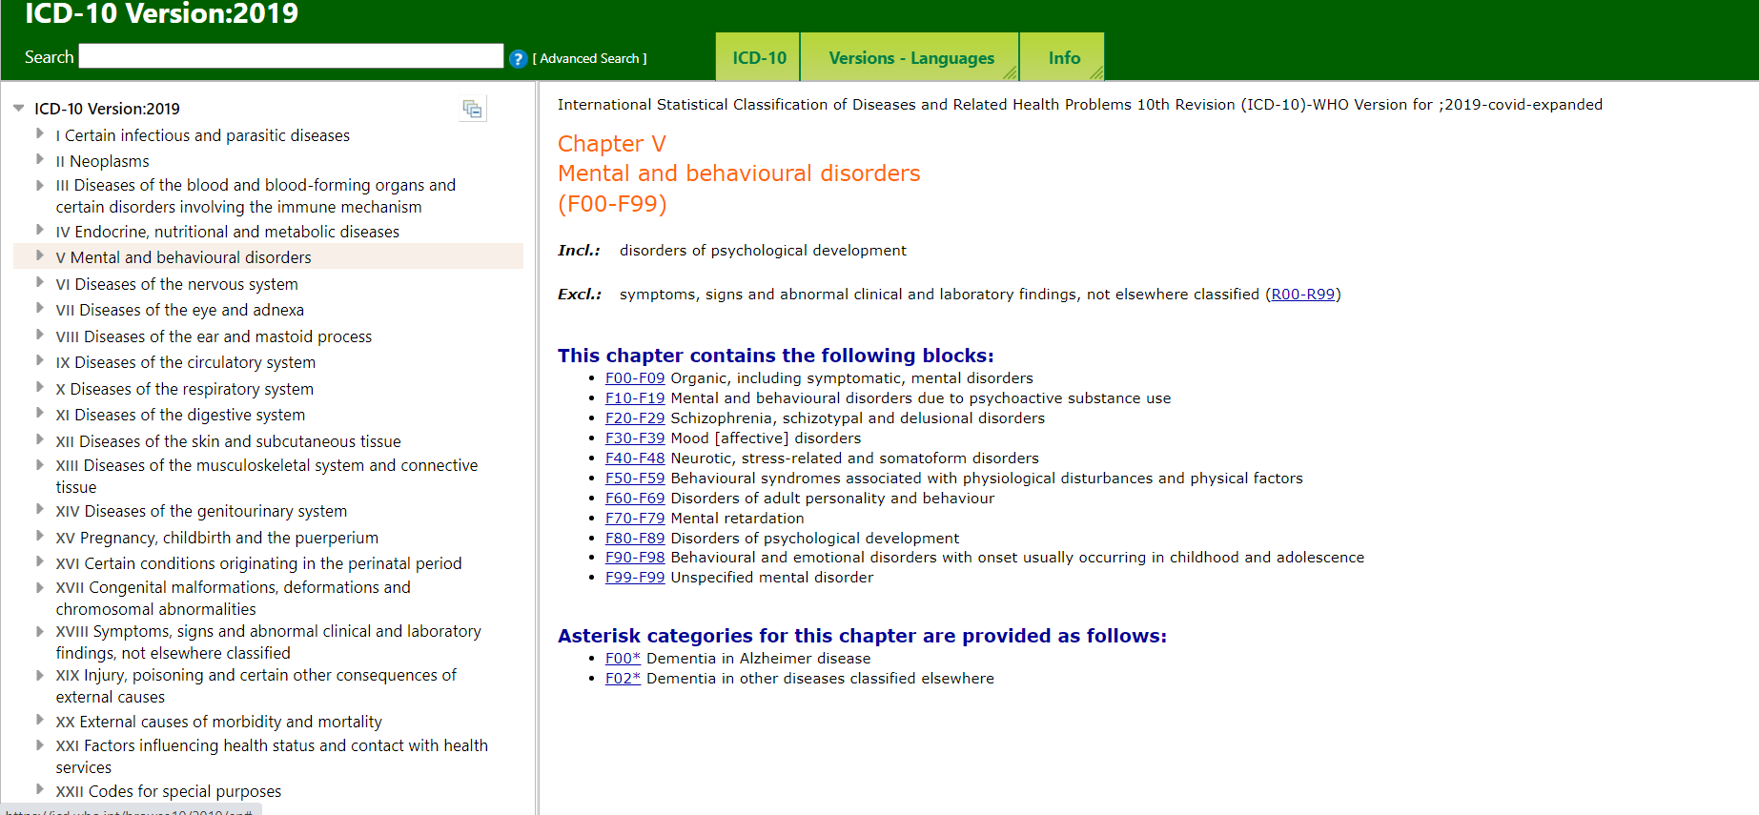
Substance use

Slide 2
Alcoholism/Smoking-Substance use
“First the man takes a drink, then the drink takes a drink; then the drink takes the man”-Japanese proverb

Slide 3
What you know about addictive behaviour?

Slide 4
Vimukthi Kerala-IIT Palakkad
NDPS Act 1985
Why do we use substances?
New forms of addictive substances?
Ill effects of addiction
Media representations –gender bias –masculinity- popular discourse
Acting out –tolerance-violence-murder -news

Slide 5
ICD-10
https://cdn.who.int/media/docs/default-source/substance-use/icd10clinicaldiagnosis.pdf?sfvrsn=96aa4de5_9&ua=1
Moral model of addiction-17th century
Excessive use of alcohol a matter of personal responsibility/free choice
Deserve punishment/not treatment
E.g. suicide
1st disease concept- 19th century
Temperance movement –evils of drink
Focus was on the substance

Slide 6
2nd disease concept- 20th century
Banning alcohol was not yielding results
Exposure is not enough
Focus was on the individuals who became addicted-legitimized sale of alcohol
Emphasised treatment
Problem with the 2nd disease model
Addict or not addict
Addiction as illness
Individual as the problem
Addiction as irreversible
Emphasises treatment
Emphasises treatment through complete abstinence

Slide 7
1970s onwards-social learning theory
Interaction between the person and other people/environment shapes behaviour
Learned behaviours (TPP)
Addiction to addictive behaviour
Can be unlearned
Lie along a continuum
Not different from other behaviours
Treatment approaches involve either total abstinence or relearning ‘normal’ behaviour patterns
Neurobiological model-dopamine system-sensitivity and activity-disproportionate activation-
Social factors (unemployment, poverty, family dysfunction) and Interpersonal factors (self-esteem, coping behaviours, attributional style)
Integrative model-eclectic model

Slide 8
Referral centres
National Drug Dependence Treatment Centre (NDDTC), Ghaziabad under AIIMS New Delhi (GOI)
Dept of Addiction Medicine, Lokopriyo Gopinath Bordoloi Regional Institute of Mental Health, Tezpur (GOI)
Centre for Addiction Medicine, NIMHANS (GOI)
S.S. Raju Centre for Addiction Psychiatry, Central Institute of Psychiatry, Ranchi (GOI)
Government medical colleges where Department of psychiatry is present
District hospitals

Slide 9
Substance use
Substance use problems
onset in adolescence generally
Increases risk of comorbid disorders in adulthood
Psychosocial difficulties in many life areas
Alcohol use lies in a continuum
abstinence (teetotaller), use, abuse, dependence
Rewarding experience –peer acceptance
Deriving pleasure to reduce pain – fatigue, pain & boredom (Mackinnon, 2017)-functional use of alcohol
Casual drinking to problematic drinking/social drinking to drinking alone

Slide 10
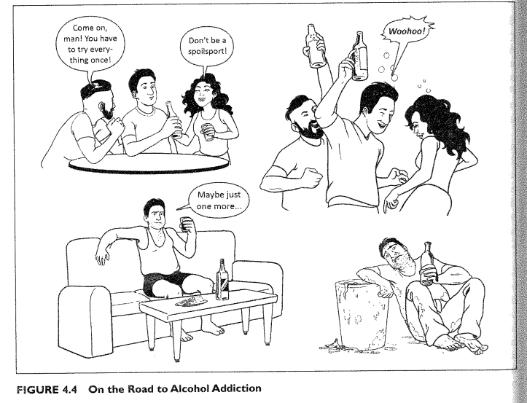
Courtesy: Hariharan (2019)

Slide 11
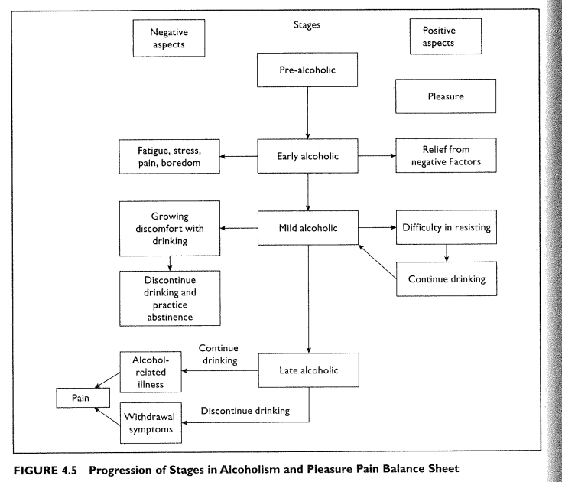
Jellnek (2018)- 4 stages of alcoholism

Slide 12
Quantity consumed, frequency and variability (regularity)
3 Cs- compulsion, loss of control, and continued use inspite of adverse consequences (Coombs, 1997; Smith & Seymour, 2001)
Conflict with law
Moral, legal, medical and psychological dimensions
Morbidity and mortality

Slide 13
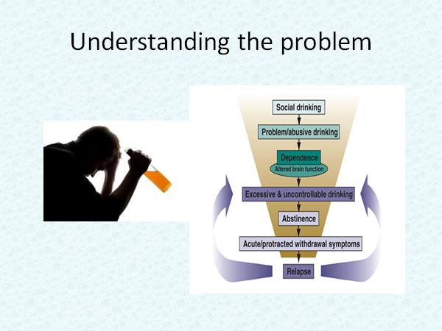

Slide 14
Impacts individuals and families
Smoking and drinking as fashionable in the media – what about the other side?
Prevention is better than cure
Seek help if needed –deaddiction centres/ mental health facility
Stress and substance use-lacking personal autonomy, personal identity- grownup children tied to apron strings of the parents, comparison and critical comments (despair, shame, hostility), people treated as commodity in IPV/DV (physical, sexual, emotional and economic abuse)
Low frustration tolerance-parents
People becoming just information seekers-lack of Concern, Acceptance, Respect, Empathy (CARE)

Slide 15
Alcohol-effects
Loss of coordination, forgetting what was done during the act
Liver cirrhosis
Increases risky behaviours, road age, risky sexual behaviour, rash driving
Drinking large amounts in one day- alcohol poisoning-coma and death
Alcohol and (domestic) violence
Harm to others resulting from behaviour during Alcohol Intoxication-DV-impact on children
Alcohol induced road accidents –Mortality and morbidity
CAGE questionnaire

Slide 16
Co-morbidity
Mental and Behavioural disorders
Alcohol-Induced Psychotic disorder
Dementia Due to Use of Alcohol
Associated with more than 200 injuries and disease conditions

Slide 17
Indian context
Licit and illicit-distilled spirits
Age at which people drink declining- longer periods of alcohol use
Solvent abuse/Cough syrup/Gum- also seen
India- 1 in 5 men and 1 in 20 women drink alcohol
India second highest tobacco-growing and consuming country
1 in 2 males and 14% of women use tobacco
Responsible for half of cancers in men and a quarter of cancers in women

Slide 18
Risk factors
Family factors-modelling, inconsistent parental discipline
Personality- low self-control, poor coping behaviour, low frustration tolerance
Peer factors- Initiation and sustenance
Loneliness- coping with painful psychological feelings
Social/developmental factors- Early use
Life cycle care and interventions
Protective factors: Strong bonding, clear rules of conduct by family, scholastic performance

Slide 19
No specific treatment
Individual/community based understanding
Instead of fitting people into categories-understand , analyse problems related to the issue
Strong relation between stressors and drinking
Chronic stress predict future drinking
Acute stress a proximal determinant of drinking episodes
Coping skills moderate the stress
Alcohol as a coping mechanism
People with less social support report problem drinking
Low self-efficacy –abstain/moderate drinking behaviour

Slide 20
Type 1 and Type 2 alcoholism
Cloninger et al.1981; Sigvardsson et al.1996
Type 1 alcoholism
Age of onset over 25 years (later onset)
No criminality or treatment for alcohol problems in the biological parents
Loss of control (or psychological dependence)
Guilt and fear about dependence
Harm avoidance
Reward dependence

Slide 21
Type 2 alcoholism
Teenage age of onset (under 25 years)-early onset
Alcohol abuse, criminality and treatment are extensive in the biological father
Inability to abstain
Aggressive behaviour –socially disruptive drinking
Novelty-seeking- heritable personality traits

Slide 22
Effects of alcohol
Effect on CNS
a blocker of messages between neurons in the central nervous system
blood alcohol concentrations (BAC) of 25 mg%- euphoria
50 to 100 mg%- lack of co-ordination and
100 to 200 mg%- unsteadiness, ataxia, poor judgement and labile mood
200 to 400 mg%- periods of amnesia
400 to700 mg%-death from coma and respiratory depression
Acute intoxication - CNS depression, leading to respiratory depression and cardiovascular collapse- death

Slide 23
Effects of alcohol withdrawal syndrome
lack of money to buy alcohol
illness or injury, nausea
decision to stop drinking
Non-accessibility-lockdown
Mild alcohol withdrawal- Occurs within 24 hours of stopping/ decreasing intake- tremulousness, anxiety, vomiting autonomic hyperactivity( sweating, tachycardia)
Moderate alcohol withdrawal -hallmark of alcoholic hallucinosis - otherwise clear sensorium
Severe alcohol withdrawal-between 24 hours and 5 days -agitation, hallucinations, severe autonomic disruption, seizures

Slide 24
Cancer -cancer in the oral cavity, pharynx, larynx and oesophagus, hepatocarcinogenesis, the risk for colorectum and breast cancer

Slide 25
Delirium tremens
“Delirium tremens is a short-lived, but occasionally life-threatening, toxic-confusional state with accompanying somatic disturbances. It is usually a consequence of absolute or relative withdrawal of alcohol in severely dependent users with a long history of use. Onset usually occurs after withdrawal of alcohol. In some cases the disorder appears during an episode of heavy drinking, in which case it should be coded here. Prodromal symptoms typically include insomnia, tremulousness, and fear. Onset may also be preceded by withdrawal convulsions. The classical triad of symptoms includes clouding of consciousness and confusion, vivid hallucinations and illusions affecting any sensory modality, and marked tremor. Delusions, agitation, insomnia or sleep-cycle reversal, and autonomic overactivity are usually also present” (ICD-10)

Slide 26
Affects frontal lobe first, then the language areas and then the medulla oblongata
Liver cirrhosis
FAS- Foetal alcoholic syndrome
Capillary haemorrhage
Family issues, absenteeism
Burden of money-increased spending, traffic accidents, loss of job, sexual risk-taking
Sexual dysfunction

Slide 27
Theories on alcoholism
Cognitive model-Family attitudes and parental behaviour can be contagious
Role of media-celebratory use –creating positive perceptions of use
Placebo effect of alcohol (Marlett et.al 1990)
Observed behaviour is not only a function of physiology but also the function of environmental, perceptual and contextual variables
Expectancies can have a big role in deciding the consequences
Integrated model
No single theory rules
Developmental psychology model-interplay of many factors-multidimensional and interdisciplinary approach

Slide 28
Intervention
Community reinforcement approach
Collateral strategies
Recreational and social opportunities
Self-help groups that foster non-using lifestyles
Problem-solving approaches
CBT
Motivational interviewing
Alcoholic Anonymous (AA)
Stress-based interventions
Context centric care

Slide 29
Behavioural addiction
Mobile phone/Internet addiction/ Video games/Gambling etc
Mobile phone and driving
Only when it is an addictive behaviour
Boredom
Interest
Context

Slide 30
Smoking
chronic bronchitis, respiratory disorders, lower birth weight in offspring, and retarded fetal development
Sexual problems –Erectile dysfunction (ED)-marital relationships-
Second-hand smoke or passive smoking- Parental cigarette smoking and cognitive performance in adolescents -low blood oxygen capacity, high carbon monoxide content

Slide 31
Synergistic effects of smoking
Depression and smoking
Lack of awareness of the synergistic effect
Smoking + drinking
Smokers impulsive- accidents and injuries at work, absenteeism, medical treatment, “use more health benefits than nonsmokers”

Slide 32
Smoking in adolescence
Initial experimentation
Peer pressure
Attitude towards smoker
Social contagion process
Runs in families
Stressors, family issues
Watching movies in which smoking is portrayed
“Smoking clusters in social networks, almost as an infectious disease might”
Infects each other through social ties
Self identity - Low self-esteem, dependency, powerlessness, social isolation

Slide 33
Exact mechanisms of nicotine addiction unknown
Nicotine changes levels of acetylcholine, norepinephrine, dopamine, endogenous opioids
Temporary improvements in performance/affect
Stopping smoking- reduced concentration/attention, anxiety, tension, moodiness

Slide 34
Smoking -effects
Chronic bad breath, loss and discolouring of teeth
Risk of stroke 1.5 times more
Risk of osteoporosis –postmenopausal smoking increases the risk of hip fracture
Harmful effect on memory and problem-solving
Erectile dysfunction, early menopause
Hair loss
Second –hand smoke- asthma, pneumonia, bronchitis
Fagerstrom test for nicotine dependence

Slide 35
Interventions
Changing Attitudes toward Smoking
Nicotine Replacement Therapy-
Social Support and Stress Management
Workplace -Family-Person
Smoking prevention programs
Narcotics Anonymous (NA)
Look at the intervention in Alcohol dependance

Slide 36
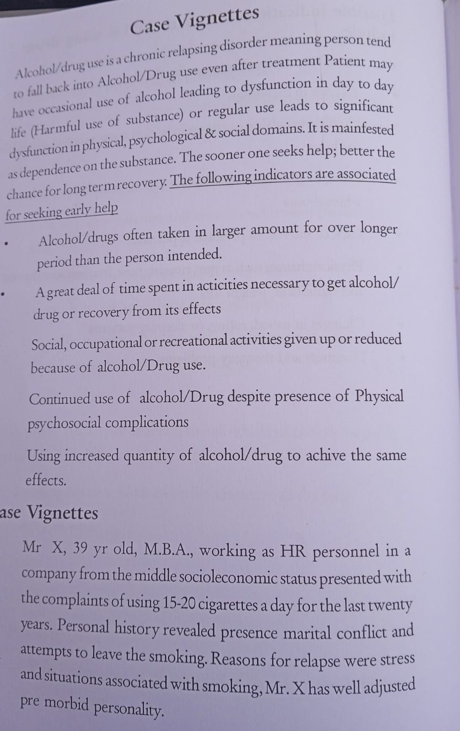
Case vignettes

Slide 37
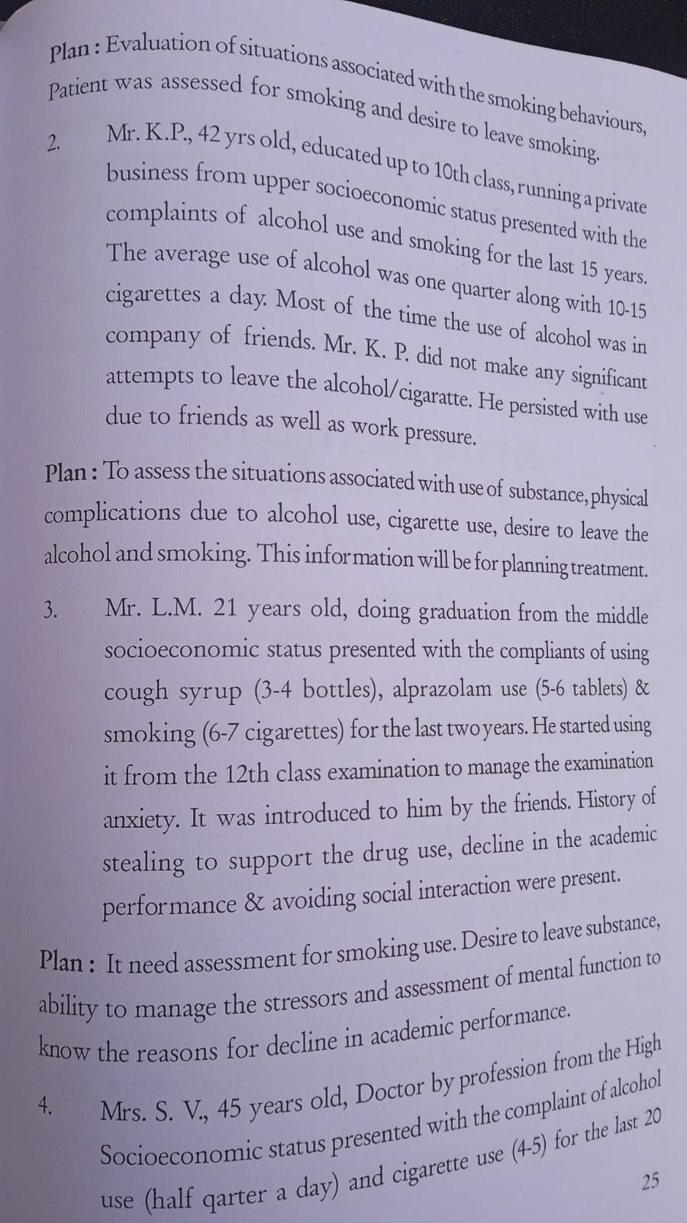

Slide 38
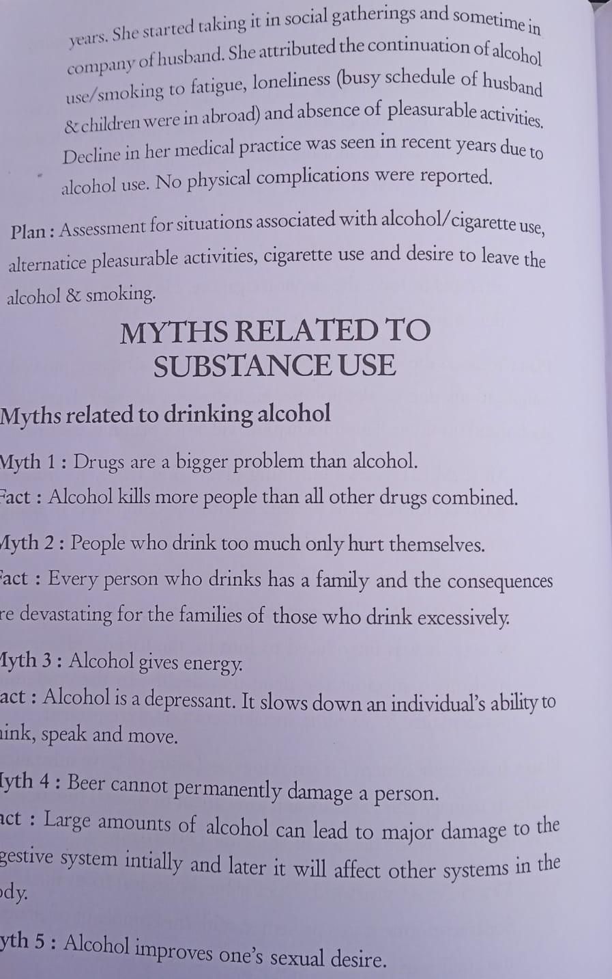

Slide 39
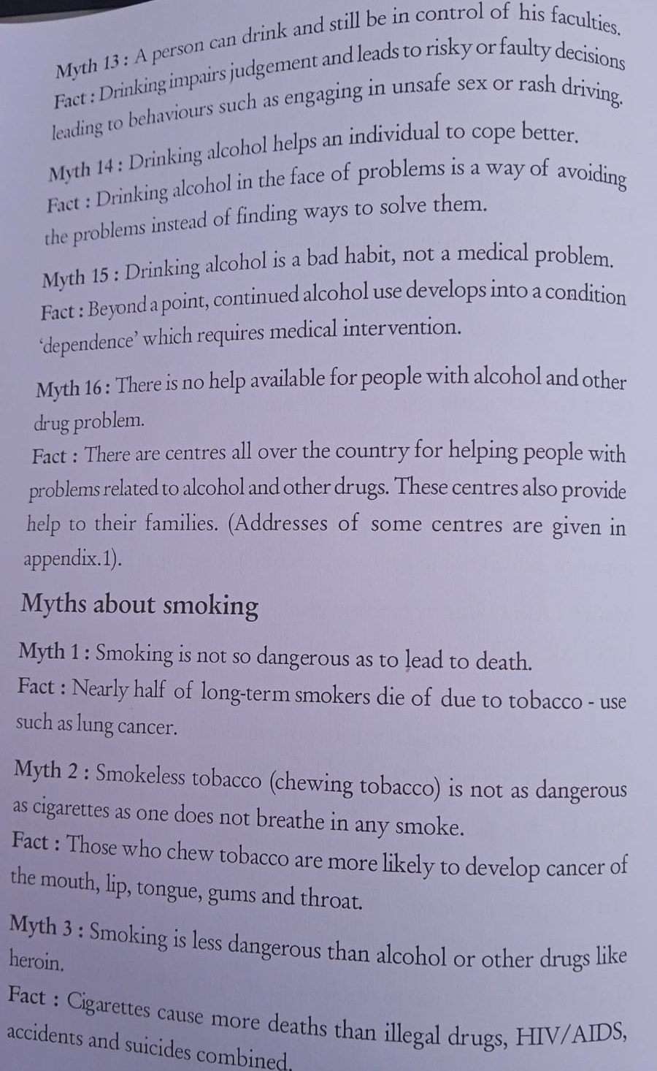

Slide 40
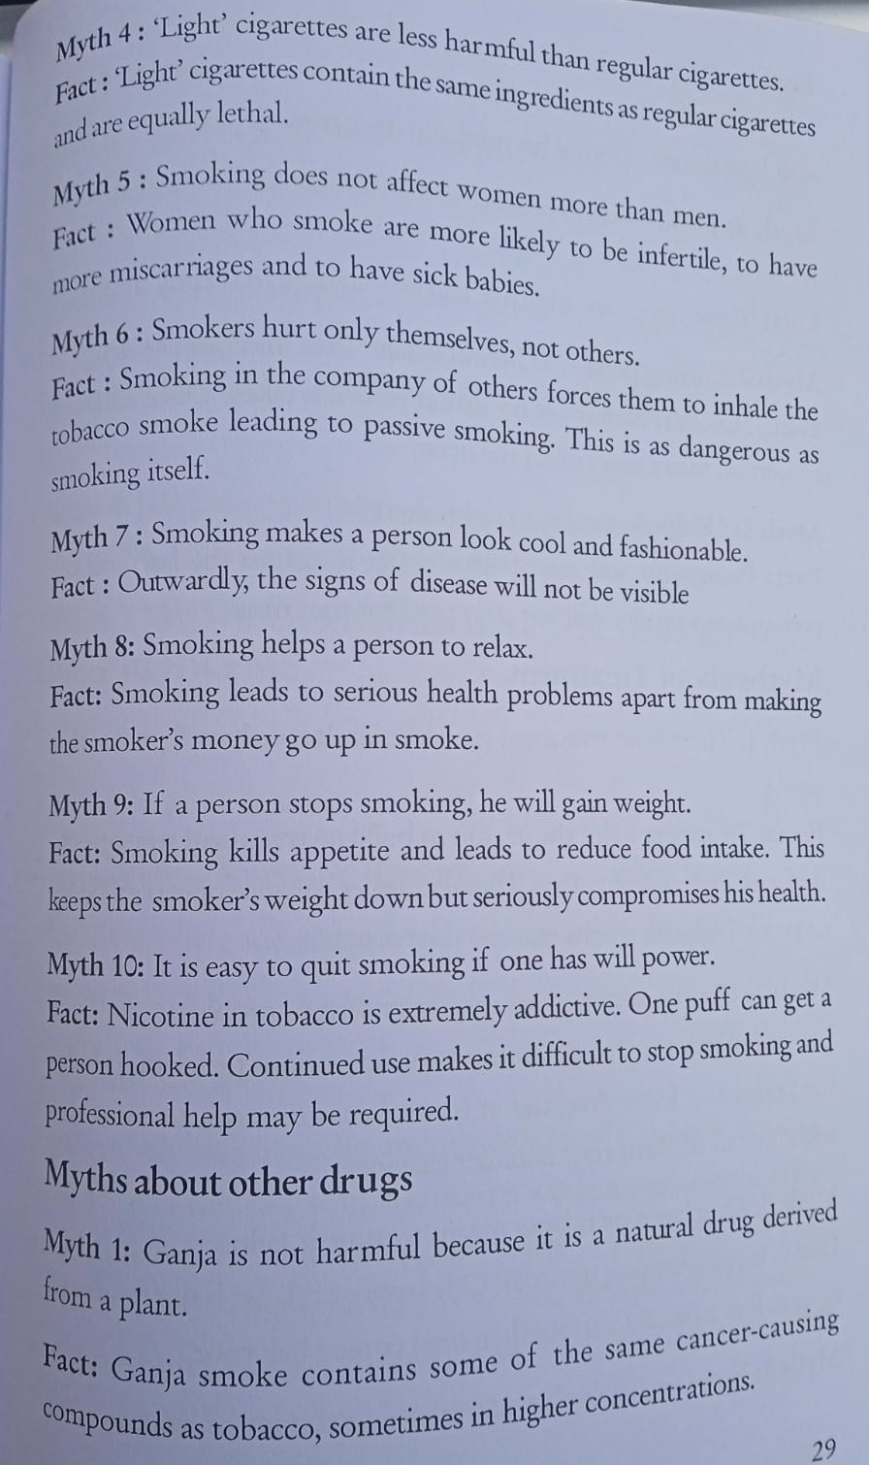

Slide 41
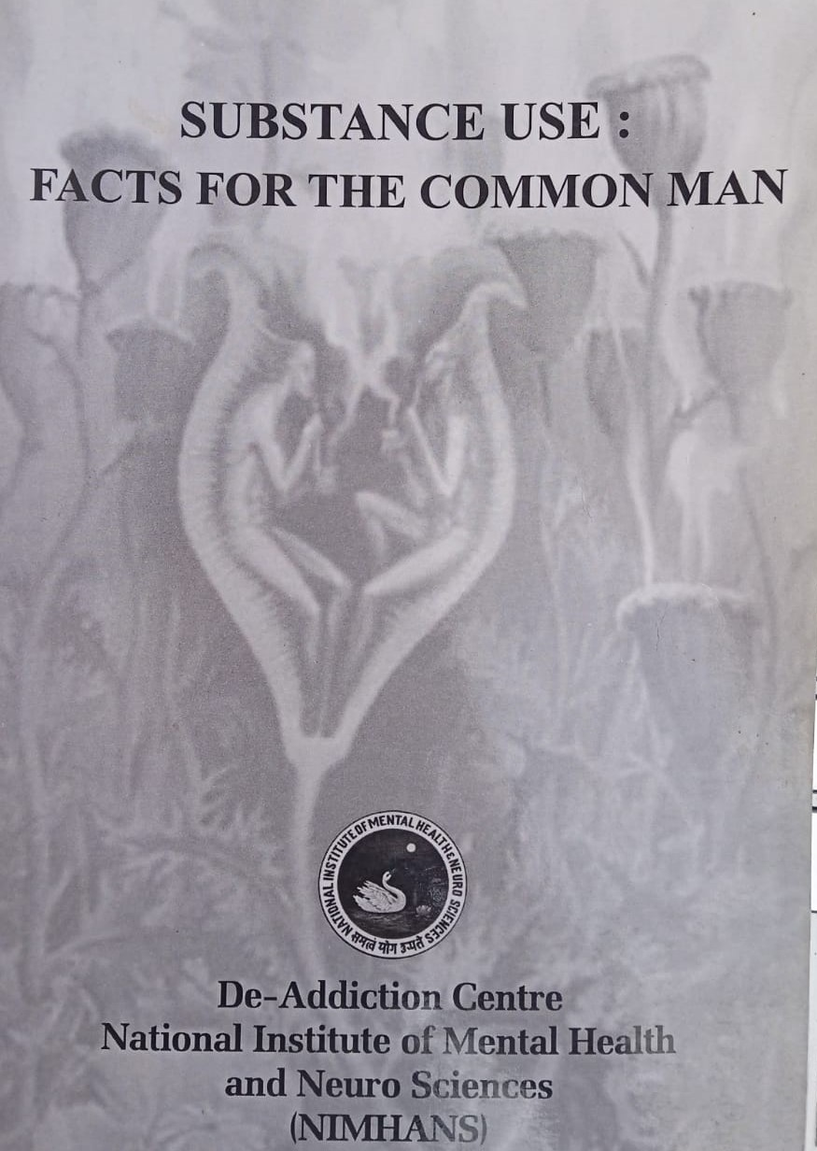
Courtesy

